Slide 1
Lent

Slide 2
Opening Prayer
Come Holy Spirit, open our ears and minds to hear the words you want to speak to us today.
Increase the capacity of our hearts to receive the love of the Father.
Help us to grow in relationship with Jesus and walk in the Kingdom. Amen

Slide 4
Gospel
A reading from the Gospel according to Luke
‘Jesus was led by the Spirit through the wilderness, being tempted there by the devil for forty days’
The Word of the Lord
R/ Thanks be to God

Slide 5
Reflection

Slide 6
Reflection

Slide 7
Reflection
All Scripture is God-breathed and is useful for teaching, rebuking, correcting and training in righteousness, so that the servant of God may be thoroughly equipped for every good work.
2 Timothy 3:16-17

Slide 8
Think and reflect…
Can you tell the difference between lies and truth?
How do you deal with temptation?
How could you learn more of the truth and live by it this Lent?
Notes:
Silence for reflection

Slide 9
Prayers of Intercession
Lord in Your mercy
R/ Hear our prayer

Slide 10
We bring all our prayers together and ask Mary to pray for us…
Hail Mary full of grace
The Lord is with thee
Blessed art thou among women
And blessed is the fruit of thy womb, Jesus.
Holy Mary, Mother of God
Pray for us sinners now and at the hour of our death
Amen

Slide 12
During Advent we raised money for the homeless in Preston.
We clothed the naked.
In Lent we are going to “feed the hungry”
‘Mary’s Meals’ provide food for the poorest children in the world.
More than 58 million of the world’s hungriest children do not attend school. In order to survive, they have to work or beg.
Even if they do make it into the classroom, hunger affects their ability to learn.
Mary’s Meals provides life-changing meals to some of the world’s poorest children every day they attend school.

Slide 14
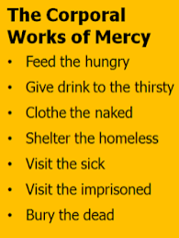
“Each tree is recognised by its own fruit”
CCC 2447 “The works of mercy are charitable actions by which we come to the aid of our neighbour in his spiritual and bodily necessities… giving alms to the poor is one of the chief witnesses to fraternal charity: it is also a work of justice pleasing to God…”

Slide 15
8p will feed a child at a school for a day.
£15.90 will feed a child at school for a year.

Slide 16
How will our House raise lots of money??

Slide 17
Corpus Christi’s Market Hall(way)
WC: Monday 28th March
The hallway to Ill Cenacolo
Forms can have a stall during their break and lunch times in the week commencing 28th March to collect tokens for their house.
Plan your stall, communicate with House captains.

Slide 18
Corpus Christi’s Got Talent – 29th March 3:00
Tickets available on Parent pay.
Show will be after school – parents welcome to attend.
Auditions starting soon.
Represent your House

Slide 19
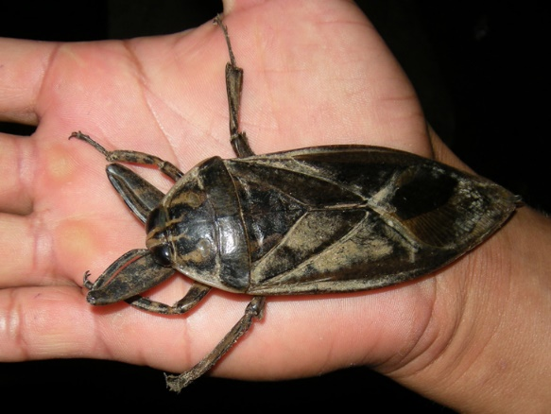
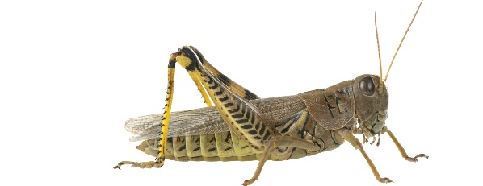
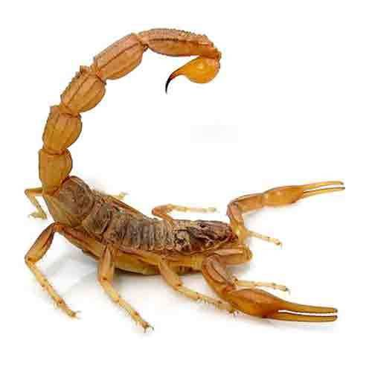
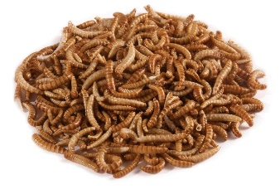
I’m a Teacher Get Me Out Of Here! – 30th March 3:00pm
Tickets available on Parent pay.
Show will be after school
Teachers of each house needed – especially Heads of House!
Come and watch them eat…

Slide 20
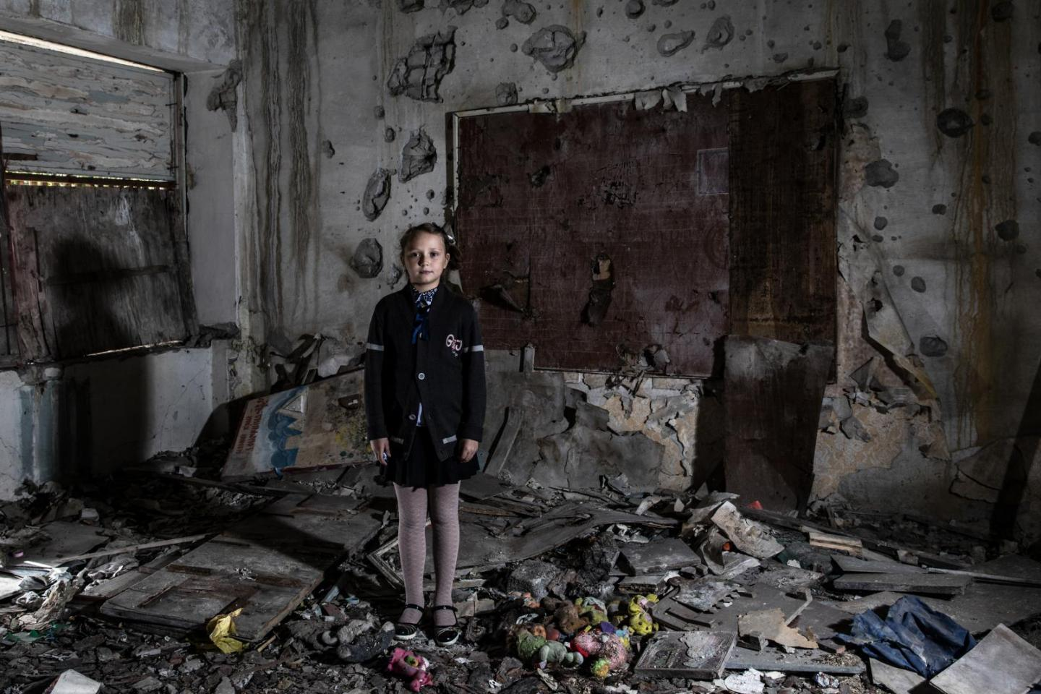
Collection for Ukraine
Dry Food pouches (eg mac and cheese)
Tea
Coffee
Hot Chocolate (made with hot water not milk)
Canned food (like soup, chilli etc)
Bandages / Wound dressings
First aid kits
Nappies
Baby Milk Formula
Baby wipes
Sanitary Towels
Disinfectant wipes
Rain ponchos
Thermal blankets
Power banks
Candles
Bring your items to the
Chaplaincy Room
By Friday 25th March at the latest
Thank you for your generosity!

